Slide 1
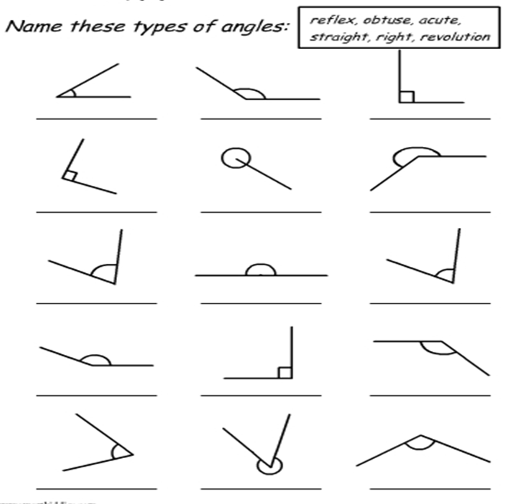
Name these angles
Notes:
revision

Slide 2
Name these angles
Obtuse
Revolution
Straight
Right
Reflex
Right
Reflex
Acute
Obtuse
Obtuse
Acute
Right
Acute
Obtuse
Acute
Notes:
solution

Slide 3
24
7
30
Date
Angles
EQ – How can we describe different angle relationships?
5
Notes:
Lesson objective (EQ)

Slide 4
Lesson objective
By the end of this lesson you will be able to;
Identify the different types of angles (complementary, supplementary etc.)
Use the angle relationships to determine unknown angles
Notes:
Lesson objective

Slide 5
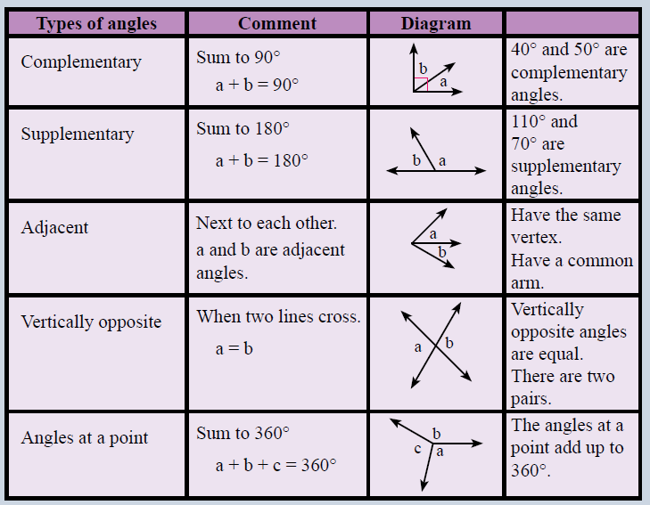
Complete the table and glue into your notes
Notes:
Hand out table to students to fill in

Slide 6
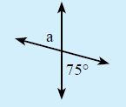

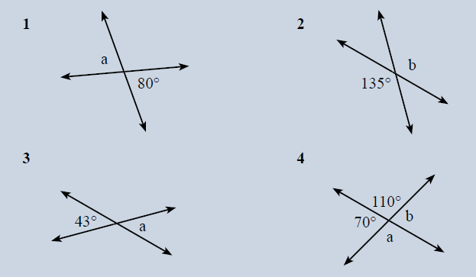
Vertically opposite Angles
Notes:
Work through example then students complete questions

Slide 7
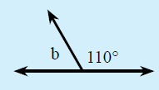

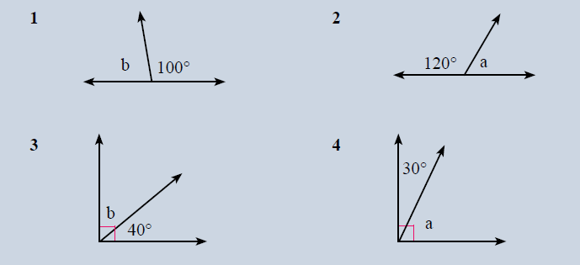
Complementary and Supplementary
Notes:
Work through example then students complete questions

Slide 8

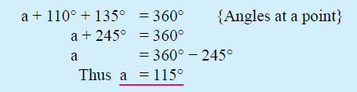
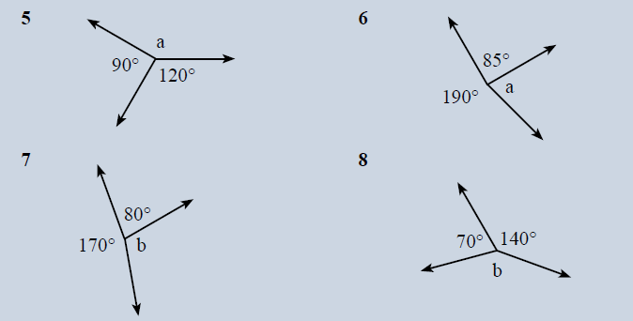
Angles at a point
Notes:
Work through example then students complete questions

Slide 9
Silent card Shuffle
Close your books!
Cut the cards out
Sort the cards into their correct groups
You have 2 minutes
Notes:
WICOR: Reading and Collaboration

Slide 10
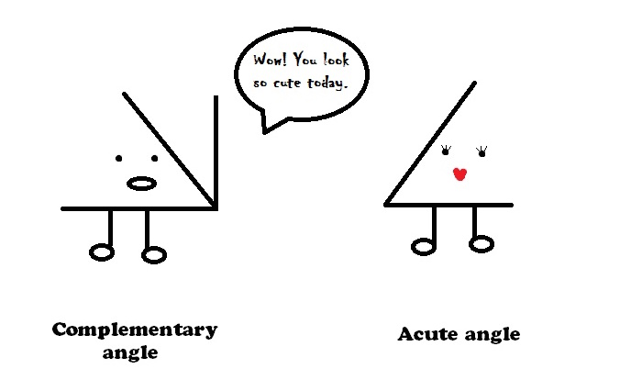
Acute math pun
Notes:
Closure

